Slide 1



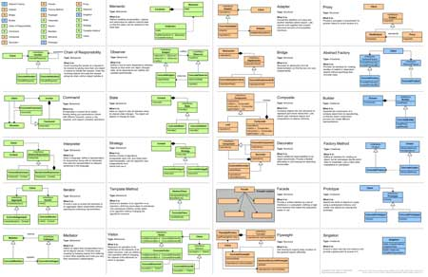
Design Patterns: Structural Design Patterns
General and reusable solutions to common problems in software design
High-Quality Code
SoftUni Team
Technical Trainers
http://softuni.bg
Software University

Slide 2

Table of Contents
Structural Design Patterns:
Façade, Composite, Proxy, Decorator, Adapter, Bridge, Flyweight
Other Design Patterns

Slide 3

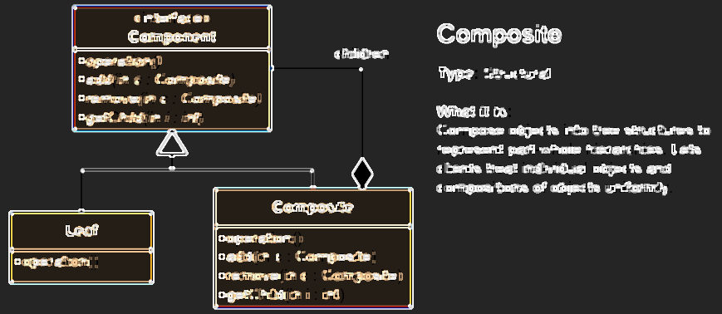
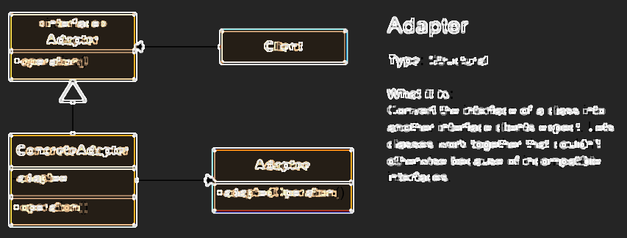
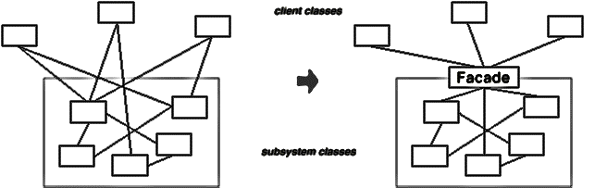
Structural Patterns

Slide 4
Structural Patterns
Describe ways to assemble objects to implement a new functionality
Make design easier by identifying a simple way to construct relationships between entities
These design patterns are about class and object composition
Structural class creation patterns use inheritance to compose interfaces
Structural object patterns define ways to compose objects to obtain new functionality

Slide 5
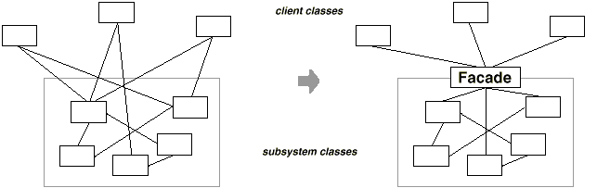
Façade Pattern
Used too deliver convenient interface from higher level to a group of subsystems or single complex subsystem
Used in many Win32 API based classes to hide Win32 complexity
http://www.dofactory.com/net/facade-design-pattern

Slide 6
Composite Pattern
Composite Pattern allows to combine different types of objects in tree structures
Gives the possibility to treat the same individual objects or groups of objects
Used when
You have different objects and you want to treat them the same way
You want to present a hierarchy of objects
http://www.dofactory.com/net/composite-design-pattern

Slide 7
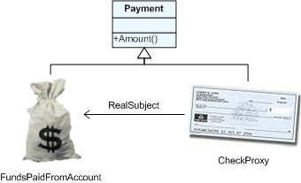
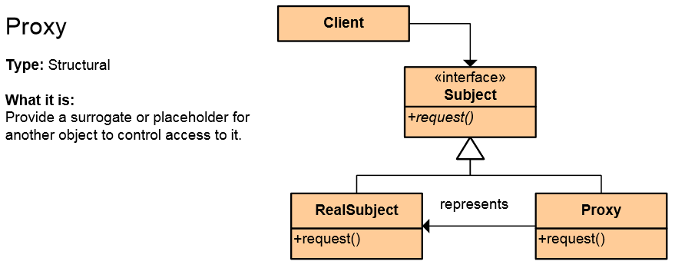
The Proxy Pattern
An object representing another object
Provide a surrogate or placeholder for another object to control access to it
Use an extra level of indirection
to support distributed, controlled, or intelligent access
Add a wrapper and delegation to
protect the real component from undue complexity
Example: Web Service
http://www.dofactory.com/net/proxy-design-pattern

Slide 8
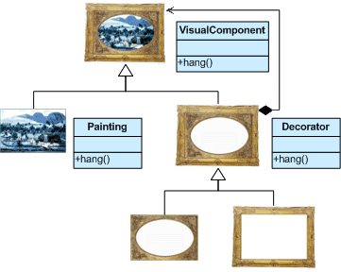
Decorator Pattern
Allows adding responsibilities to objects dynamically
Wrapping original component
Alternative to inheritance (prevents class explosion problem)
Support Open-Closed principle
In .NET: CryptoStream decorates Stream
http://www.dofactory.com/net/decorator-design-pattern

Slide 9
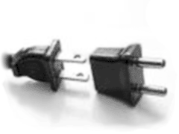
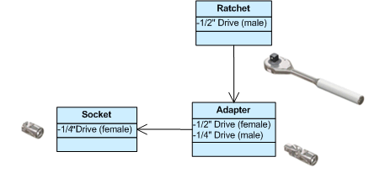
Adapter Pattern
Converts a class interface into another class requested by the client
Wrap an existing class with a new interface
Impedance match an old component to a new system
Allows classes to work together when this is impossible due to incompatible interfaces
http://www.dofactory.com/net/adapter-design-pattern

Slide 10

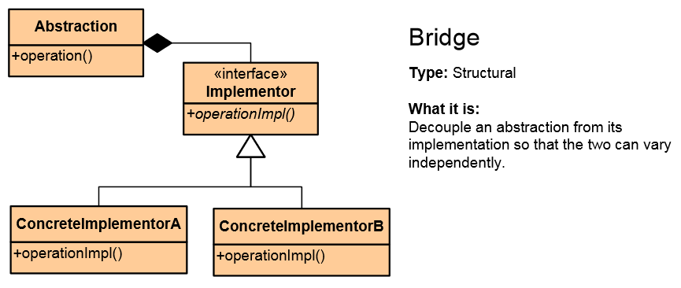
Bridge Pattern
Used to divide the abstraction and its implementation (they are coupled by default)
That way both can be rewritten independently
Solves problems usually solved by inheritance
From: Abstraction -> Implementation To: Abstraction -> Abstraction -> Implementation
http://www.dofactory.com/net/bridge-design-pattern

Slide 11
Proxy vs. Decorator vs. Adapter vs. Bridge
Proxy – to lazy-instantiate an object, or hide the fact that you're calling a remote service, or control access to the object (one-to-one interface)
Decorator – to add functionality to an object runtime (not by extending that object's type)
Adapter – to map an abstract interface to another object which has similar functional role, but a different interface (changes interface for the client)
Bridge – to define both the abstract interface and the underlying implementation. You're not adapting to some legacy or third-party code, you're the designer of all the code but you need to be able to swap out different implementations (all changeable)

Slide 12
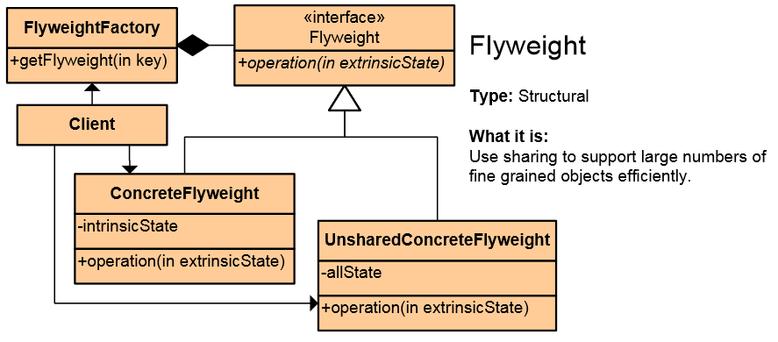
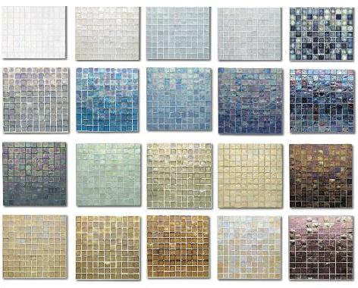
Flyweight Pattern
Use sharing to support large numbers of fine-grained objects efficiently
Reduce storage costs for large number of objects
Share objects to be used in multiple contexts simultaneously
Retain object oriented granularity and flexibility
http://www.dofactory.com/net/flyweight-design-pattern

Slide 13

Summary
Structural Design Patterns:
Façade, Composite, Proxy, Decorator, Adapter, Bridge, Flyweight
Other Design Patterns

Slide 14








Structural Design Patterns
https://softuni.bg/courses/high-quality-code

Slide 15

License
This course (slides, examples, demos, videos, homework, etc.) is licensed under the "Creative Commons Attribution-NonCommercial-ShareAlike 4.0 International" license
Attribution: this work may contain portions from
"Fundamentals of Computer Programming with C#" book by Svetlin Nakov & Co. under CC-BY-SA license
"High Quality Code" course by Telerik Academy under CC-BY-NC-SA license

Slide 16






Free Trainings @ Software University
Software University Foundation – softuni.org
Software University – High-Quality Education, Profession and Job for Software Developers
softuni.bg
Software University @ Facebook
facebook.com/SoftwareUniversity
Software University @ YouTube
youtube.com/SoftwareUniversity
Software University Forums – forum.softuni.bg

